Slide 1

MIDTerm presentation on Coin Nexus
ATHARVA PRAMOD NIMBALWAR (002625645)
KARAN SRINIVAS (002474804)
MOINUDDIN MOHAMMED (002275124)
UTTARSH BHARADIA (002872928)

Slide 2
Overview
Coin Nexus is a pioneering cryptocurrency trading and investment platform designed to democratize access to the digital finance world.
Our mission is to simplify the cryptocurrency experience, catering to both novices and seasoned investors through a secure, intuitive interface.
We emphasize user empowerment, providing tools and resources for informed decision-making in the fast-paced crypto market.
Coin Nexus bridges the gap between complex financial technologies and user-friendly operations, fostering a community of informed users ready to navigate the cryptocurrency landscape confidently. Join us in reshaping the future of finance, where innovation meets accessibility

Slide 3
Problem Statement
Navigating the cryptocurrency market can be daunting for many due to its complexity, volatility, and the technical knowledge required. Potential investors often feel overwhelmed by the array of platforms, each with its unique interface and varying levels of security and support. This fragmentation leads to confusion, inhibiting entry and engagement in the cryptocurrency space.

Slide 4
SOLUTION
Coin Nexus addresses the challenges of navigating the cryptocurrency market with a suite of intuitive and powerful features designed to make trading and investing in cryptocurrencies accessible and efficient for everyone. Here's how we solve the problem:
Streamlined Buying and Selling: Our platform simplifies the process of buying and selling cryptocurrencies with an easy-to-use interface, catering to both novice investors and experienced traders
Personalized Watchlist: Users can customize their watchlist to monitor the performance of their favorite cryptocurrencies, making it easier to stay informed about market movements
In-Depth Market Analysis: With comprehensive charts and analytics tools, users gain insights into cryptocurrency trends, helping them make data-driven decisions

Slide 5
SOLUTION
Efficient Stock Search: Our robust search functionality allows users to quickly find and explore a wide range of cryptocurrencies, ensuring they have all the information they need at their fingertips.
Comprehensive Portfolio Management: Coin Nexus enables users to manage their investments and track the performance of their portfolio in real-time, offering a clear overview of their financial position.
Transparent Order Management: The platform provides detailed tracking of both placed and completed orders, offering users full transparency over their transactions.
User-Friendly Account Management: With features that streamline the sign-up, login, and account recovery processes, including forgotten and reset password options, we ensure that managing your account is straightforward and secure.

Slide 6
Style guide : Color theme with design specifications
Color Palette: Buy Button (Green), Sell Button (Red), Watchlist Button (Light Blue), Menu Buttons (Grey)
Consistency for Recognition: Maintain consistent color scheme for cohesive user experience and easy navigation.
Accessibility and Readability: Ensured colors meet accessibility standards with high contrast for improved readability.
Psychological Impact and Trust: Leveraged color psychology to evoke trust and align emotions with user interactions.

Slide 7
Product Objectives
At Coin Nexus, our product objectives are aligned with our mission to simplify the cryptocurrency trading and investment process, making it accessible and beneficial for a broad audience. Our goals are designed to address user needs, drive growth, and foster a secure and dynamic cryptocurrency ecosystem.
Key Objectives:
Enhance User Experience:
To provide a seamless, intuitive interface that reduces the complexity of cryptocurrency transactions for users of all experience levels.
Ensure Security and Trust:
To implement top-tier security measures that protect user data and funds, building a platform users can trust with their investments.

Slide 8
PRODUCT OBJECTIVES
Drive User Engagement and Growth:
To create engaging, informative content and tools that attract new users and retain existing ones, encouraging active participation in the cryptocurrency market.
Offer Comprehensive Market Insights:
To deliver real-time data and analytics, enabling users to make informed decisions based on market trends and performance indicators.
Innovate Continuously:
To stay at the forefront of technology, constantly updating and refining our platform to incorporate new features and capabilities that meet evolving market and user needs.

Slide 9
Target Audience
Cryptocurrency Enthusiasts: Individuals with a passion for cryptocurrency trends
Novice Investors: Young adults and professionals, particularly those aged 18-35, new to cryptocurrency and looking for an easy-to-navigate platform to start their investment journey
Experienced Traders: Adults who are seasoned traders looking for a platform with advanced tools and analytics to enhance their trading decisions
Tech-Savvy Millennials and Gen Z: Digitally native individuals, especially those aged 18-30, attracted to innovative financial technologies and interested in cryptocurrency as part of their investment portfolio
Financial Analysts: Professionals interested in deep market insights and analytics for reporting, advising, or personal investment decisions

Slide 10

User Needs
User-Friendly Interface: Users need an intuitive interface that allows them to easily navigate through the application, view market data, and execute trades without confusion or frustration.
Reliable Market Data: Users require accurate and real-time market data to make informed trading decisions. Any delays or inaccuracies in data could lead to potential losses.
Security: Users need robust security measures to protect their funds and personal information from unauthorized access, hacking, or theft. This includes features like two-factor authentication, encryption, and secure login procedures.
Wide Range of Cryptocurrencies: Users may have diverse investment preferences, so they need access to a wide range of cryptocurrencies for trading, including popular ones like Bitcoin and Ethereum, as well as newer altcoins.
Fast and Efficient Trading: Users expect the trading platform to execute their buy and sell orders quickly and efficiently, especially during times of high market volatility when speed is crucial.

Slide 11
USER NEEDS
Transparent Fees: Users need clear information about trading fees, withdrawal fees, and any other charges associated with using the platform. Hidden fees or unclear fee structures can lead to dissatisfaction among users.
Regulatory Compliance: Users need assurance that the platform complies with relevant regulatory requirements and operates within legal boundaries. This helps build trust and confidence in the platform's legitimacy.
Market Volatility: Cryptocurrency markets are highly volatile, which can lead to rapid price fluctuations and increased risk for traders. Users may need to adapt their trading strategies to mitigate the impact of market volatility.
Legal and Compliance Constraints: Compliance with legal requirements, such as anti-money laundering (AML) and know your customer (KYC) regulations, can impose constraints on the platform's operations and user experience, particularly regarding account verification and transaction monitoring.

Slide 12
ONBOARDING
Onboarding is crucial for any cryptocurrency trading application like CoinNexus to ensure that users can quickly and effectively start using the platform.
It helps familiarize users with the features, functions, and overall user experience, ultimately leading to higher user retention and satisfaction.
These onboarding pages provide users with a seamless introduction to CoinNexus, guiding them through account setup, educating them on security best practices, and encouraging them to get started with cryptocurrency trading.

Slide 13
Here's why onboarding is necessary
Introduction to Platform Features: Onboarding provides users with an overview of the platform's key features, such as trading, market analysis tools, portfolio management, and security measures. This helps users understand how they can utilize the platform to achieve their trading goals.
Guidance on Account Setup: Onboarding guides users through the account setup process, including registration, verification, and funding options. Clear instructions and prompts ensure that users can complete these steps smoothly and efficiently.
Education on Cryptocurrency Trading: For novice users, onboarding serves as an educational tool by providing basic information about cryptocurrency trading, market dynamics, risk management strategies, and tips for successful trading. This empowers users to make informed decisions while navigating the platform.
Customization Options: Onboarding may also introduce users to customization options, such as setting up watchlists, creating personalized trading alerts, adjusting chart preferences, and exploring advanced trading settings. This allows users to tailor the platform according to their preferences and trading style.

Slide 14
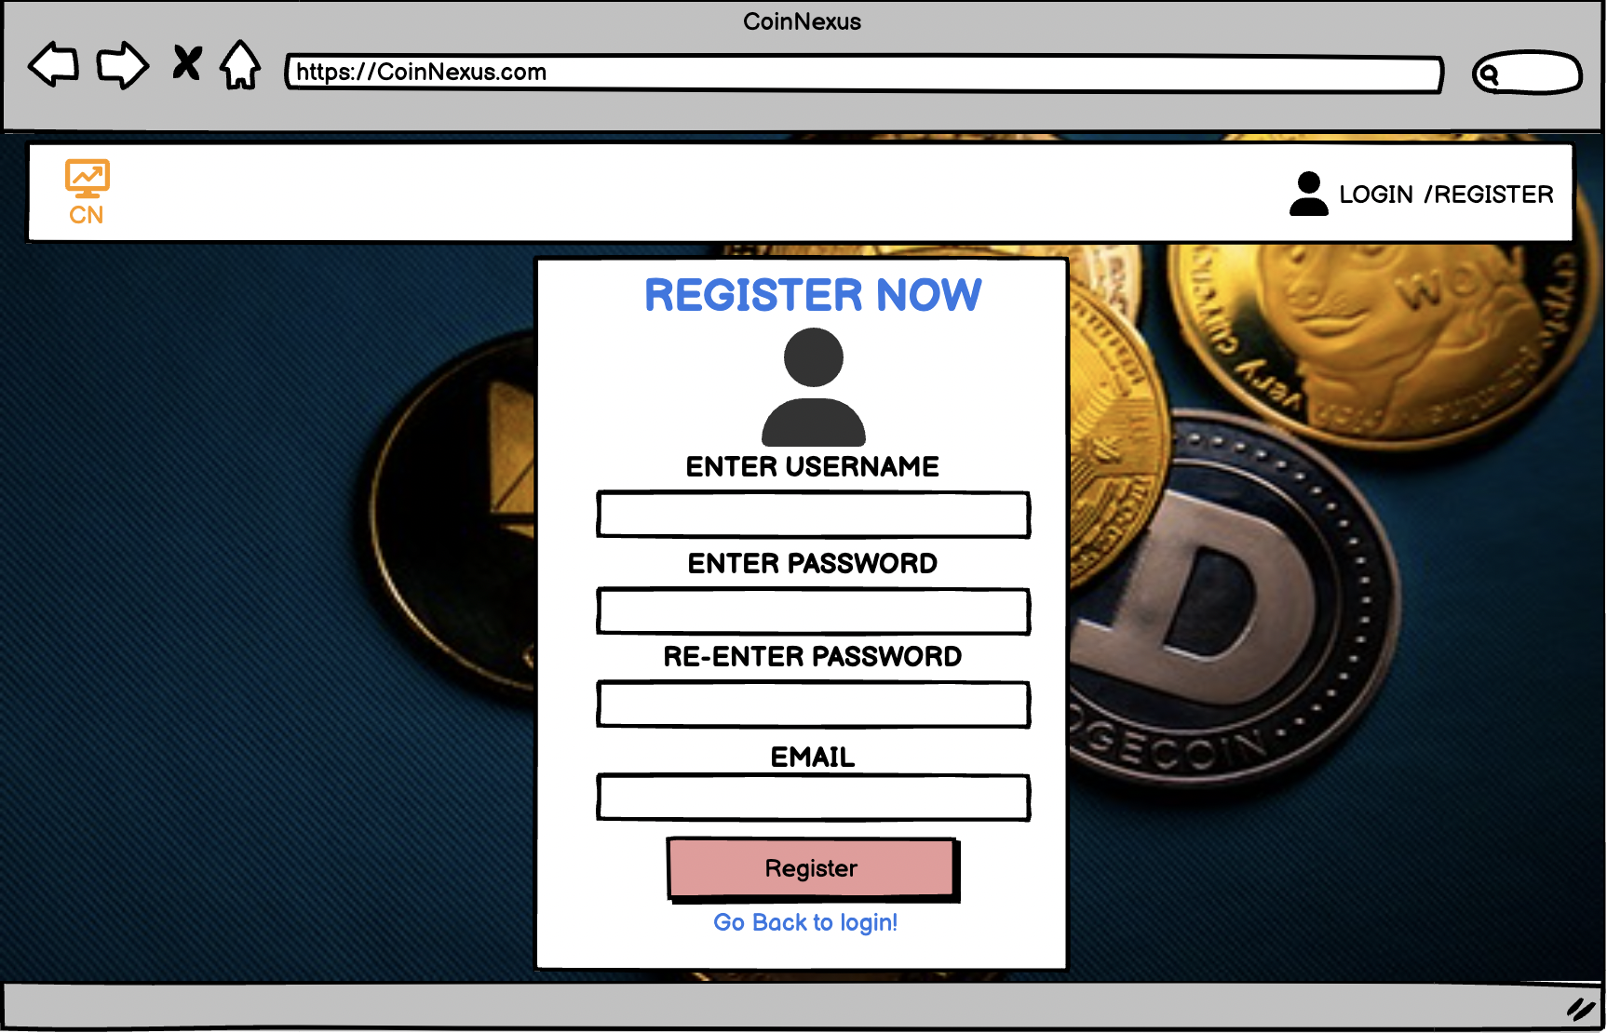
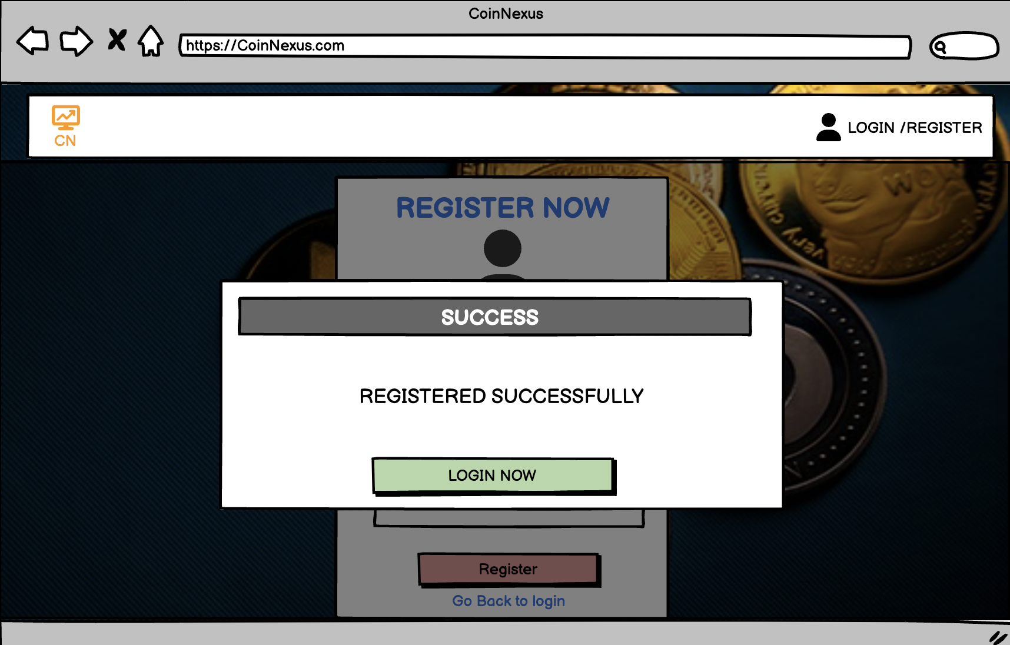
Onboarding Page 1: Register

Slide 15
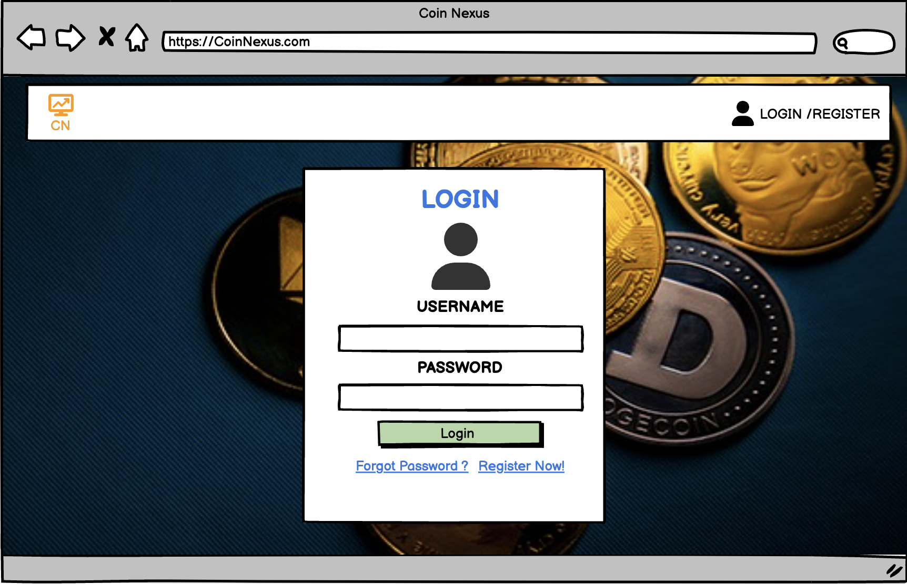
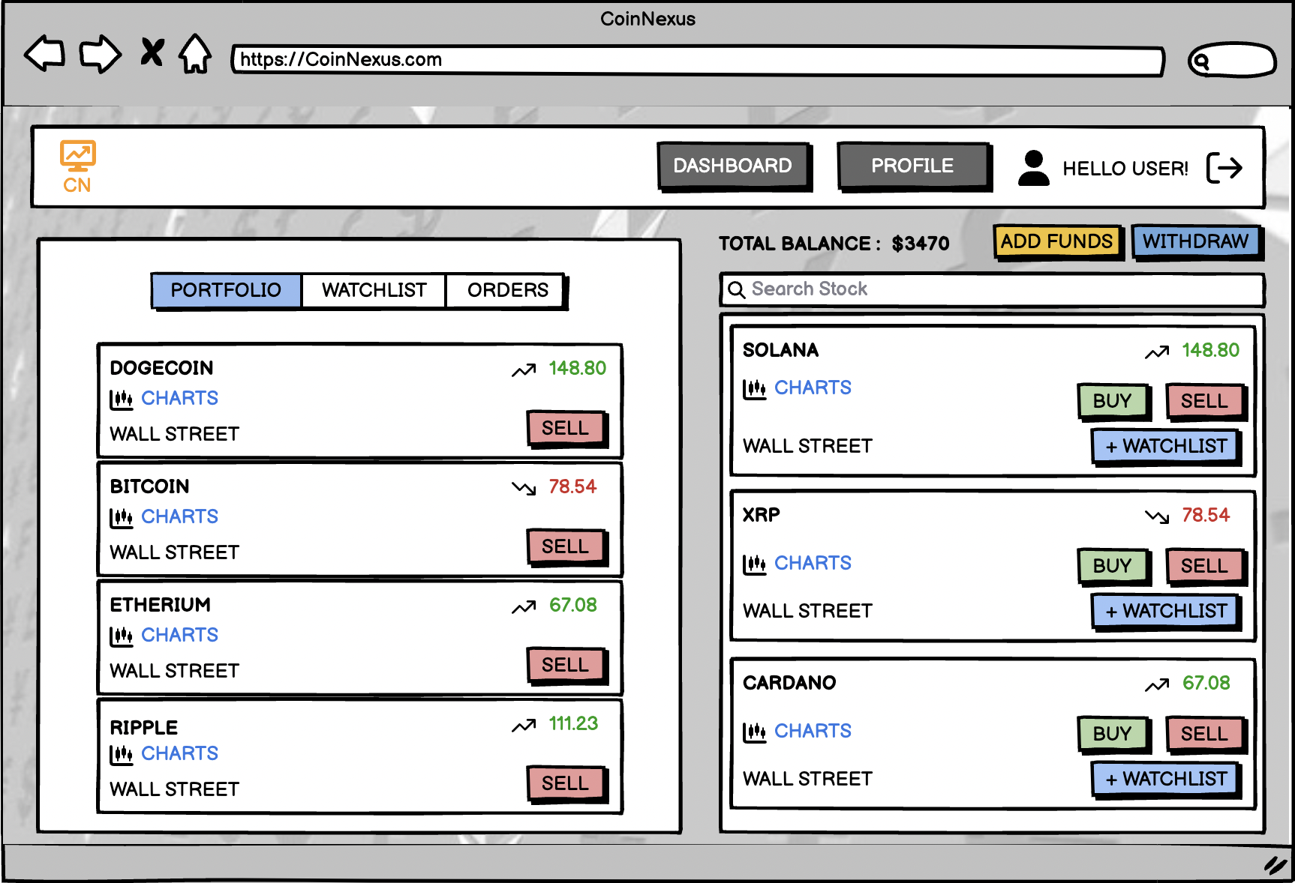
Onboarding Page 2: Login To Dashboard

Slide 16
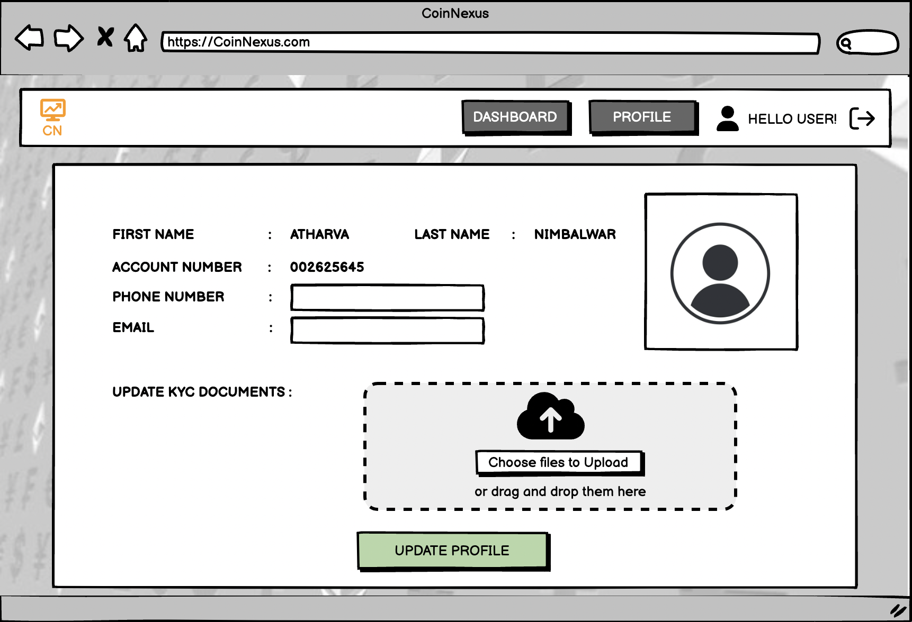
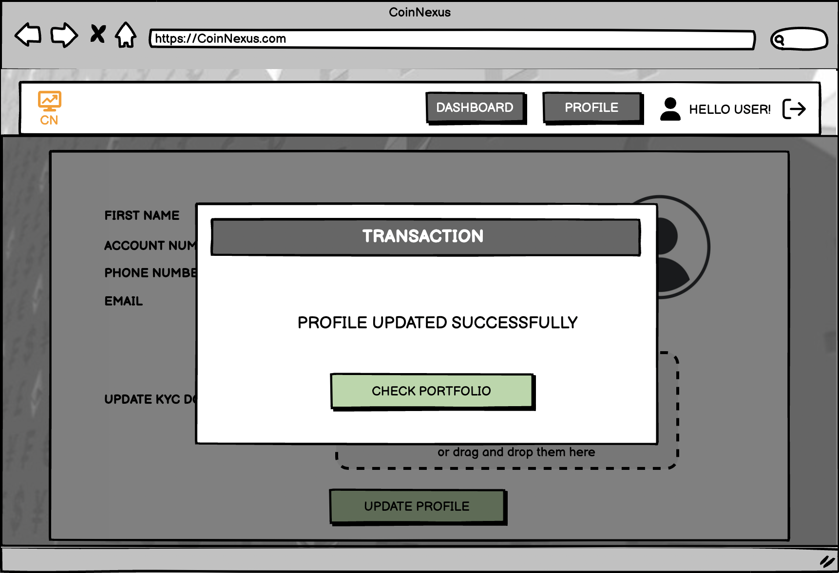
Onboarding Page 3: UPDATE PROFILE

Slide 17
USE CASES
CoinNexus has uses cases ranging from middleweight to heavyweight, showcasing various scenarios in which users can leverage the platform.
CoinNexus aims to empower users with the tools, resources, and insights they need to navigate the dynamic and evolving world of cryptocurrency trading and investment effectively.
Whether you're a casual trader, experienced investor, or institutional client, CoinNexus strives to meet your needs and support your journey in the digital asset market.

Slide 18
heavyweight USE CASE
USE CASE 1 | USE CASE 2
Title: Execute a Crypto Trade Actor: Trader Overview: The trader wants to perform a crypto trade using the platform, involving buying or selling of a specific cryptocurrency. Subject Area: Trading Trigger: Trader initiates a trade from the trading dashboard. Precondition: The trader has sufficient funds in their account. Basic Flow: Trader selects the cryptocurrency to trade. Chooses between buying or selling. Enters the quantity and any additional parameters. Confirms the trade. Alternate Flow 1: If the trade request fails due to insufficient funds, the system prompts the trader to add funds. Alternate Flow 2: If the selected cryptocurrency is temporarily unavailable, the system notifies the trader and suggests an alternative. Post Condition: The trade is executed successfully, and the trader's account balance is updated. | Title: Update KYC Information Actor: User Overview: The user needs to update their KYC (Know Your Customer) information on the platform for compliance purposes. Subject Area: User Profile Trigger: User clicks on the profile button and selects KYC update. Precondition: User is logged in and wants to update their KYC information. Basic Flow: User clicks on the profile button. User provides updated email, phone number, and uploads the required KYC documents. Confirms the changes. Alternate Flow 1: If the uploaded KYC document is rejected, the system provides details on the issue, and the user is prompted to re-upload. Alternate Flow 2: If the user cancels the KYC update midway, the system retains the existing information. Post Condition: Updated KYC information is recorded and verified by the platform.

Slide 19
MIDDLEWEIGHT Use cases
USE CASE 3 | USE CASE 4
Title: Add Cryptocurrency to Watchlist Actor: Trader Basic Flow: Trader navigates to the trading dashboard. Selects a specific cryptocurrency. Chooses the "Add to Watchlist" option. The system adds the selected cryptocurrency to the trader's watchlist. Alternate Flow 1: If the selected cryptocurrency is not available, the system notifies the trader and suggests alternatives. Alternate Flow 2: If the trader attempts to add a cryptocurrency already in the watchlist, the system prompts for confirmation to avoid duplicates. | Title: Withdraw Funds Actor: Trader Basic Flow: Trader navigates to the funds management section. Selects the "Withdraw Funds" option. Inputs the withdrawal amount and withdrawal destination details. Confirms the withdrawal request. Alternate Flow 1: If the withdrawal amount exceeds the available balance, the system prompts the trader to enter a valid amount. Alternate Flow 2: If the withdrawal destination details are incomplete or incorrect, the system prompts the trader to provide accurate information.

Slide 20
Persona 1: Novice Investor - Emma
Background
Emma is a 28-year-old marketing professional with little experience in cryptocurrency trading.
She heard about the potential profits in the crypto market and decided to start investing but finds the process overwhelming.
Frustrations
Complexity: Emma finds cryptocurrency trading platforms intimidating and confusing, especially with terms like "wallets," "exchanges," and "private keys."
Lack of Guidance: She struggles to find clear guidance on how to get started with investing in cryptocurrencies and often feels lost when trying to navigate the CoinNexus platform.

Slide 21
PERSONA 1: NOVICE INVESTOR - EMMA
Goals
Education: Emma wants easy-to-understand educational resources and tutorials within CoinNexus to help her grasp the basics of cryptocurrency trading and investment.
Simplicity: She seeks a user-friendly interface with intuitive navigation and straightforward terminology to reduce confusion and make the trading process more accessible.
Confidence: Emma aims to gain confidence in her ability to invest in cryptocurrencies wisely and hopes to see gradual progress in her investment portfolio over time.

Slide 22
Persona 2: Experienced Trader Seeking Efficiency - Alex
Background
Alex is a 35-year-old finance professional with several years of experience in cryptocurrency trading.
He actively trades cryptocurrencies as part of his investment strategy and relies on CoinNexus for executing trades and managing his portfolio.
Frustrations
Lack of Advanced Features: Alex feels limited by the lack of advanced trading features and tools on CoinNexus, such as algorithmic trading options or customizable trading strategies.
Slow Execution: He finds the execution speed of trades on CoinNexus slower compared to other trading platforms, especially during periods of high market volatility.

Slide 23
PERSONA 2: EXPERIENCED TRADER SEEKING EFFICIENCY - ALEX
Goals
Advanced Trading Tools: Alex seeks access to advanced trading tools and features within CoinNexus, such as advanced charting, technical analysis indicators, and order types to refine his trading strategies.
Efficiency: He aims for faster and more efficient trade execution on CoinNexus, ensuring that his orders are executed promptly and accurately to capitalize on market movements.
Diversification: Alex wants CoinNexus to expand its offerings to include a broader range of cryptocurrencies and trading pairs, allowing him to diversify his investment portfolio and explore new market opportunities.

Slide 24
SWOT ANALYSIS
SWOT analysis is a strategic planning tool used to evaluate the Strengths, Weaknesses, Opportunities, and Threats involved in a project or business venture.
It helps organizations identify internal and external factors that may impact their ability to achieve their objectives and develop strategies to address them effectively.
By leveraging its strengths, addressing weaknesses, capitalizing on opportunities, and mitigating threats, CoinNexus can position itself for sustainable growth and success in the competitive cryptocurrency market.
Overall, conducting a SWOT analysis for CoinNexus provides valuable insights that can inform strategic decision-making, risk management, and competitive positioning, ultimately contributing to the platform's long-term success and sustainability in the cryptocurrency market.

Slide 25
STRENGTHS
User-Friendly Interface: CoinNexus boasts an intuitive and easy-to-use interface, making it accessible to both novice and experienced cryptocurrency traders.
Security Measures: The platform implements robust security measures, including two-factor authentication, encryption protocols, and cold storage for user funds, enhancing trust and confidence among users.
Diverse Cryptocurrency Offerings: CoinNexus provides access to a wide range of cryptocurrencies and trading pairs, allowing users to diversify their investment portfolios and capitalize on emerging market opportunities.
Advanced Trading Tools: CoinNexus offers advanced trading tools and features, such as real-time market data, charting tools, technical indicators, and order types, empowering users to make informed trading decisions.

Slide 26
WEAKNESS
Limited Market Penetration: CoinNexus may face challenges in gaining market share and attracting users compared to more established cryptocurrency exchanges with larger user bases and brand recognition.
Customer Support: Some users may experience delays or inefficiencies in CoinNexus's customer support, impacting their overall experience, especially during times of technical issues or account-related inquiries.
Regulatory Compliance: Adhering to evolving regulatory requirements in different jurisdictions can pose challenges for CoinNexus, potentially limiting its operational flexibility and expansion into new markets.

Slide 27
OPPORTUNITIES
CoinNexus can expand its services beyond trading, such as offering DeFi products or educational resources.
Forming partnerships with financial institutions or blockchain projects can unlock new growth opportunities.
Targeting new markets globally can help CoinNexus capitalize on the growing demand for cryptocurrency trading.

Slide 28
THREATS
Competition from established and emerging exchanges poses a threat to CoinNexus's market share.
Security risks in the cryptocurrency industry, such as hacking attacks, can undermine user trust.
Regulatory uncertainty may present challenges for CoinNexus in terms of compliance and legal requirements.

Slide 29
USER JOURNEY MAP
This user journey map outlines the typical steps a user like Sarah might take when interacting with CoinNexus, from initial awareness to ongoing engagement and improvement.
It helps CoinNexus understand the user experience and identify opportunities for enhancing usability, addressing pain points, and delivering value to its users.
Using a user journey map for CoinNexus enables the platform to gain valuable insights into the user experience, optimize key touchpoints, and drive continuous improvement, ultimately leading to higher user satisfaction, engagement, and retention.

Slide 30
User Journey Map for Coin Nexus
1. Awareness:
Scenario: Sarah hears about CoinNexus through social media or word-of-mouth.
Action: Sarah visits the CoinNexus website or downloads the mobile app to learn more.
Outcome: Sarah gains a basic understanding of CoinNexus's features and capabilities.
2. Registration and Onboarding:
Scenario: Sarah decides to sign up for an account on CoinNexus to start trading cryptocurrencies.
Action: Sarah completes the registration process, providing necessary information and verifying her email address.
Outcome: Sarah's account is successfully created, and she proceeds to the onboarding process.

Slide 31
USER JOURNEY MAP FOR COIN NEXUS
3. Education and Training:
Scenario: Sarah, as a novice trader, seeks guidance on how to use CoinNexus effectively.
Action: Sarah explores the educational resources available on CoinNexus, such as tutorials, articles, and guides.
Outcome: Sarah gains knowledge about cryptocurrency trading strategies, market analysis tools, and risk management techniques.
4. Exploration of Features:
Scenario: Sarah begins exploring CoinNexus's features and functionalities.
Action: Sarah navigates through the platform, familiarizing herself with the trading interface, market data, and portfolio management tools.
Outcome: Sarah feels comfortable using CoinNexus and starts planning her first trades.

Slide 32
USER JOURNEY MAP FOR COIN NEXUS
5. Execution of Trades:
Scenario: Sarah decides to execute her first cryptocurrency trades on CoinNexus.
Action: Sarah selects the cryptocurrencies she wants to buy or sell, sets the desired parameters, and confirms the trades.
Outcome: Sarah's trades are executed successfully, and she can track their progress in her portfolio.
6. Monitoring and Analysis:
Scenario: Sarah monitors the performance of her trades and analyzes market trends.
Action: Sarah uses CoinNexus's charting tools, technical indicators, and news feeds to assess market conditions and make informed decisions.
Outcome: Sarah adjusts her trading strategy based on market analysis, optimizing her portfolio for potential growth.

Slide 33
USER JOURNEY MAP FOR COIN NEXUS
7. Continuous Improvement and Engagement:
Scenario: Sarah continues to use CoinNexus for her cryptocurrency trading activities.
Action: Sarah provides feedback and suggestions for improvement through user surveys or feedback forms.
Outcome: CoinNexus uses user feedback to iterate and improve its platform, enhancing user satisfaction and retention.

Slide 34
COMPETITIVE ANALYSIS
CoinNexus competes effectively with its competitors by offering a diverse product range, competitive pricing, a user-friendly interface, and a strong focus on customer experience.
Its marketing approach emphasizes accessibility, security, and advanced features, positioning it as a trusted and reliable cryptocurrency trading platform in the market.
Overall, a competitive analysis is essential for CoinNexus to stay competitive and thrive in the fast-paced cryptocurrency exchange market.
By understanding its competitors and the broader market dynamics, CoinNexus can make informed decisions to drive growth, enhance its brand, and deliver value to its users.

Slide 35
COMPETITIVE ANALYSIS
Comparsion Point | CoinNexus | Binance
Product Range | Offers a diverse range of cryptocurrencies and trading pairs, along with advanced trading tools and features. | Provides an extensive selection of cryptocurrencies and trading pairs, including futures contracts and options.
Pricing Strategy | Competitive trading fees with discounts for high-volume traders and loyalty programs. | Low trading fees and additional discounts for using Binance Coin (BNB).
Brand Positioning | Positioned as a user-friendly and secure cryptocurrency trading platform with a focus on accessibility and advanced features. | Positioned as the world's leading cryptocurrency exchange, known for its low fees and wide range of trading options.
Marketing Approach | Utilizes a combination of digital marketing channels, social media engagement, and educational content to attract and retain users. | Known for its aggressive marketing campaigns, influencer partnerships, and frequent promotions to attract new users.
Customer Experience | Prioritizes user experience with a user-friendly interface, responsive customer support, and regular updates to improve platform functionality. | Offers a seamless trading experience with fast order execution, 24/7 customer support, and a comprehensive knowledge base for users.

Slide 36
CONCLUSION
Leverage Competitive Advantages: By understanding its strengths relative to competitors, CoinNexus can capitalize on its unique features, user-friendly interface, and robust security measures to attract and retain users.
Address Weaknesses: Identifying areas where CoinNexus may lag behind competitors allows the platform to address weaknesses, such as customer support inefficiencies or regulatory compliance challenges, to improve overall user experience.
Innovate and Differentiate: Insights gained from analyzing competitors enable CoinNexus to innovate its product offerings, pricing strategies, and marketing approaches to stand out in the crowded cryptocurrency exchange market.
Stay Responsive and Adaptive: With the cryptocurrency market constantly evolving, regular competitive analysis ensures that CoinNexus remains agile and responsive to changes, enabling it to adapt its strategies and offerings to meet evolving user needs and market dynamics.

Slide 37
THANK YOU!

